Slide 1





BUSINESS DATA MANAGEMENT:
CAPSTONE PROJECT
Forecasting Optic Fiber Deployment
for enhanced Revenue Planning
Archit Handa (22f2000744)
1

Slide 2
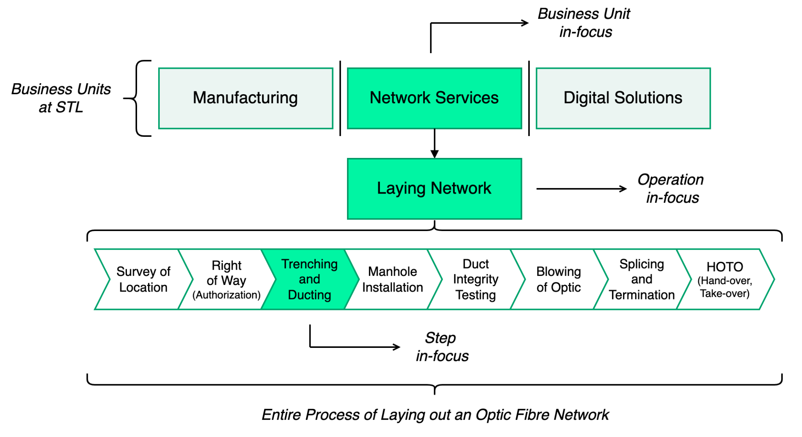

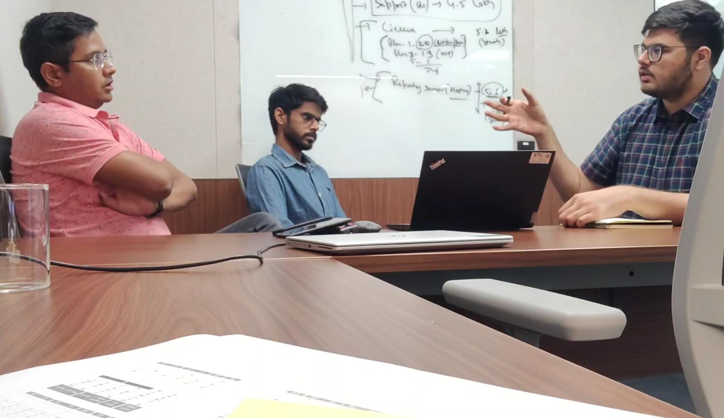
Business Overview
Sterlite Technologies Limited (STL) is a global
optical and digital solutions company, which aims to deliver end-to-end data network solutions to its clients. STL currently operates in the B2B segment.
Project Focus:.
Trenching and Ducting (T&D), a crucial step in laying out optic fiber, thus in Capacity and overall Revenue Planning for the Organisation
Business Problem:.
Inability to estimate optic fiber layout output for a month leading to deviations from Revenue Projections which causes delays in Turn Around Time (TAT) and Resource Wastage.
People of Contact:.
Mr. Pankaj Singh
PMO Lead at STL
Mr. Shailendra Kumar
PMO Analytics Engineer at STL
Solution:.
Machine Learning Model that integrates concepts of Linear Regression and Time Series Analysis.
2

Slide 3
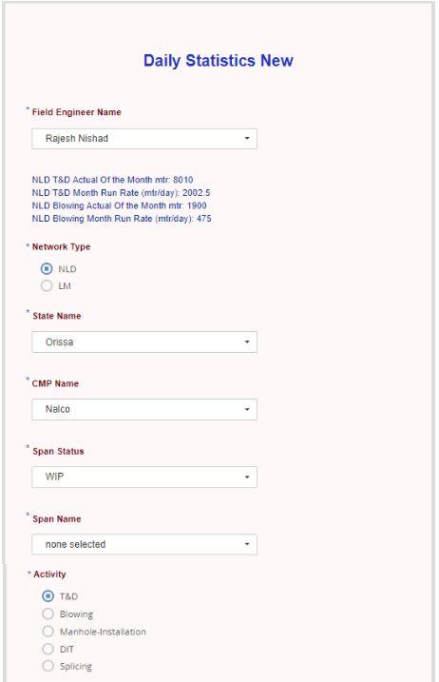
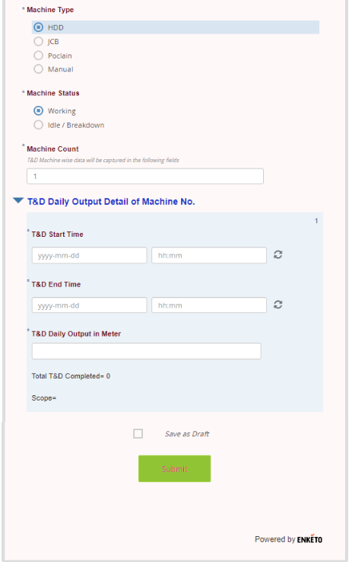
Data Collection
Data Preprocessing
Data collected using STL’s in-house tool: FieldForce
Daily details input by Field Engineer
Data collected from October 2021 till date
Step 1: Imputation
Unusable fields were dropped such as Field Engineer Details
Missing values were filled according to patterns exhibited
First 3-month data was extremely noisy due to field engineers’ unawareness regarding the tool → Dropped for further analysis
Step 2: Aggregation
Current state captures span-wise data; however, planning is to be performed for all spans in the country as a whole
Daily Statistics allow granularity; however, from modeling perspective, can cause the estimator to overfit
Step 3: Feature Engineering
Work Duration = Machine End Time - Machine Start Time
Daily Productivity = Daily Output (in meter) / Machine Count
3

Slide 4
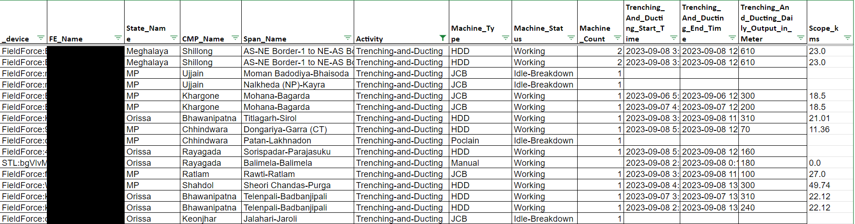
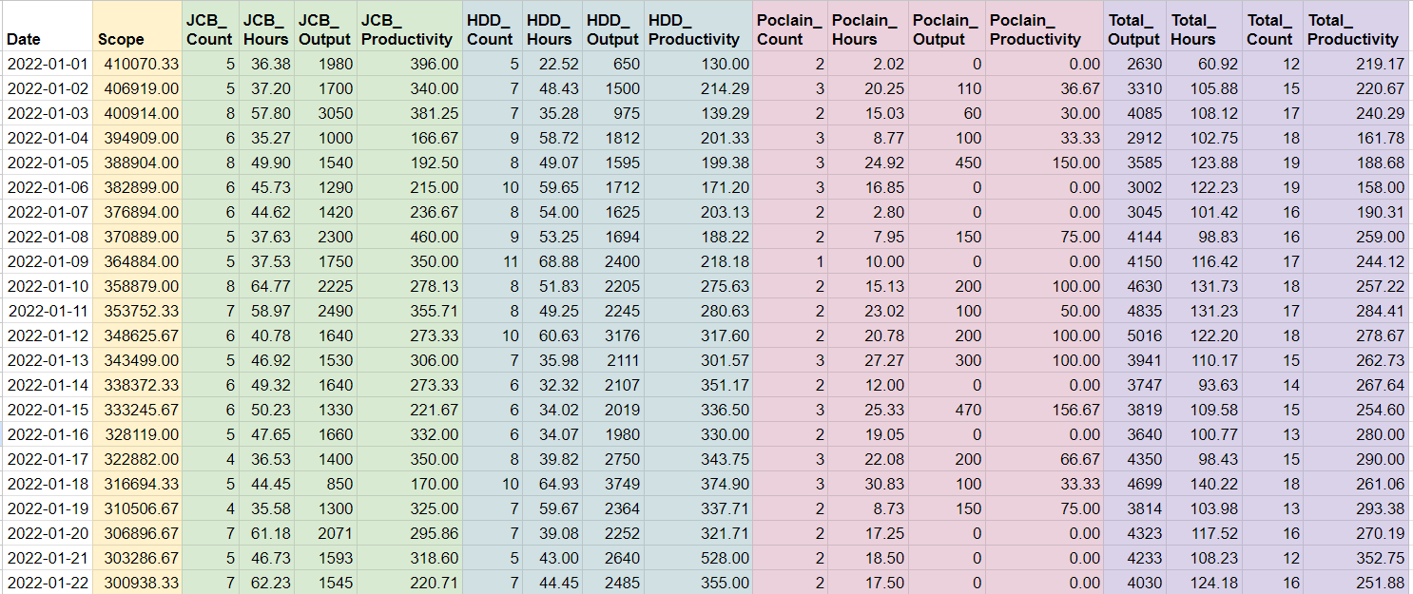
Raw Data before Processing
Data Tools
MS Excel, Pandas,
Numpy, Scikit-Learn
Cleaned Data after Processing
4

Slide 5
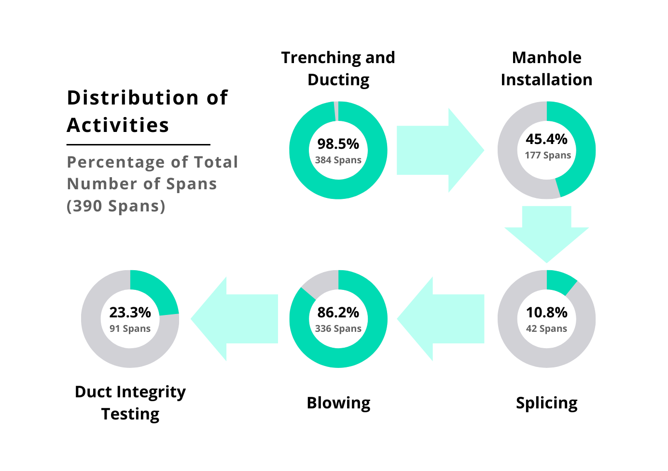
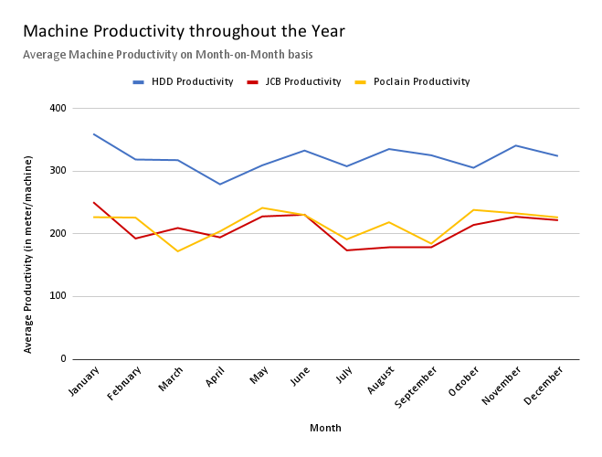
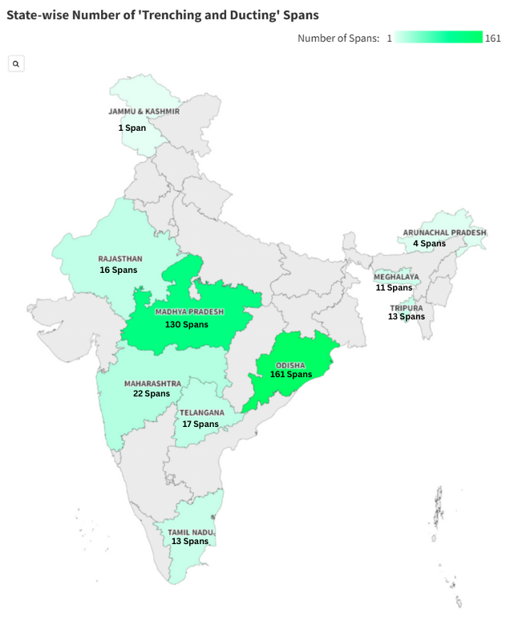
Descriptive Statistics
Data available from various soil and weather landscapes
Positive from a modeling viewpoint
Manhole Installation, Splicing, and DIT are quick to execute
T&D and Blowing go hand-in-hand with a 10-day lag
Significant Weight of T&D in Overall Capacity Planning
HDD has highest productivity
Fluctuations hint at certain cyclical patterns that should be decoded
5

Slide 6
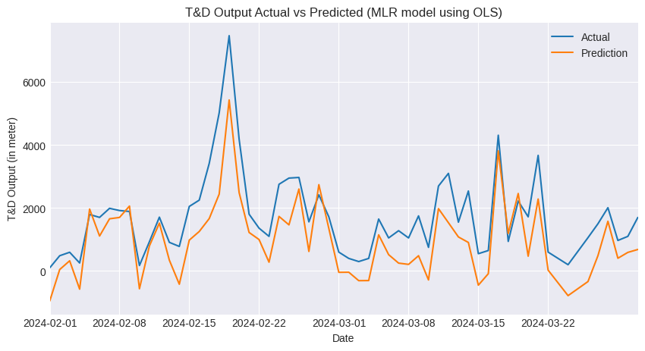
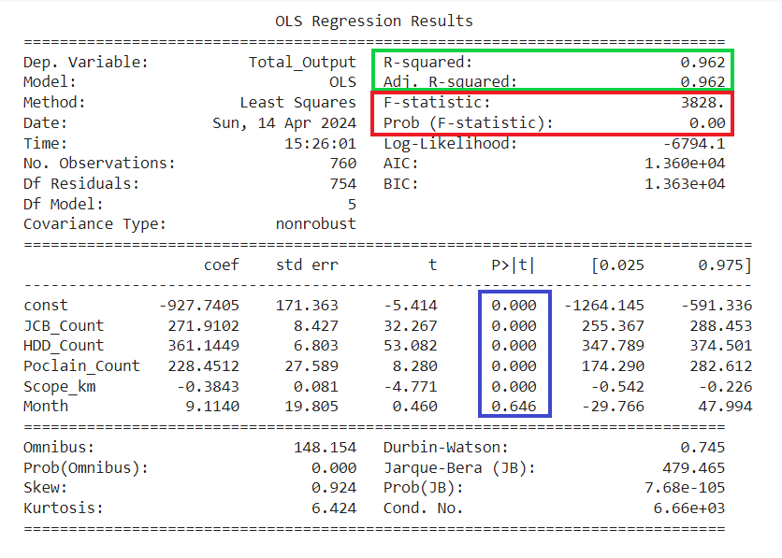
Data Analysis and Modelling
Linear Regression: MLR OLS
Metrics
R2 Score shows Overfitting:
0.962 (Train) | 0.478 (Test)
Percentage Difference:
44.53%
Accurately predicts the Spikes and Dips
Does not consider the Month variable, hence the Seasonality Effect
6

Slide 7
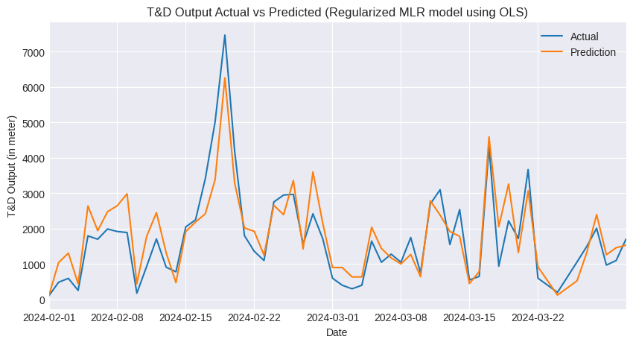
Data Analysis and Modelling
Linear Regression: Regularized MLR OLS with ⍺ = 10
Regularization used to tackle problem of Overfitting
Metrics
R2 Score shows Good Fit:
0.958 (Train) | 0.807 (Test)
Percentage Difference:
6.3%
Statistically, much better than MLR OLS
Yet still does not consider the Seasonality Effect
7

Slide 8
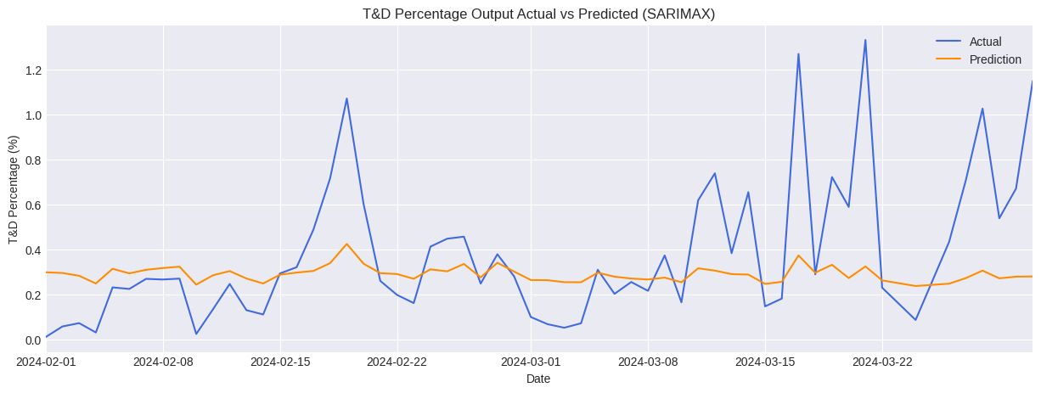
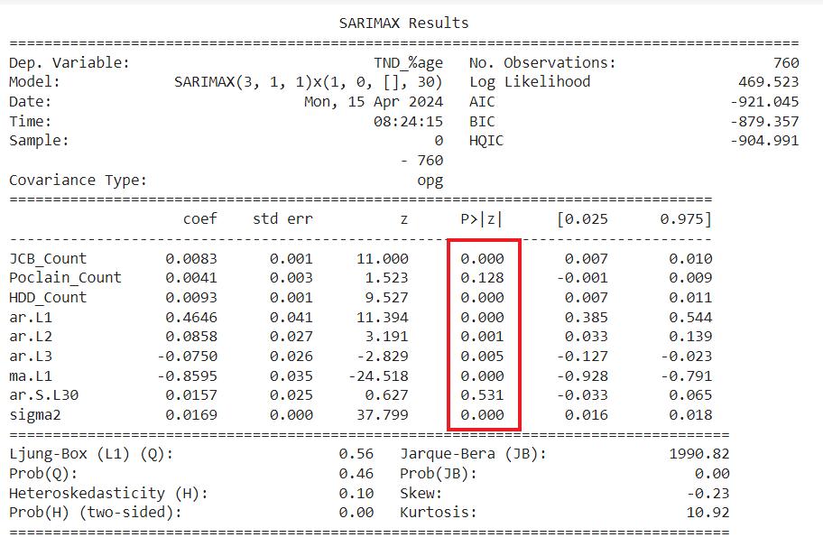
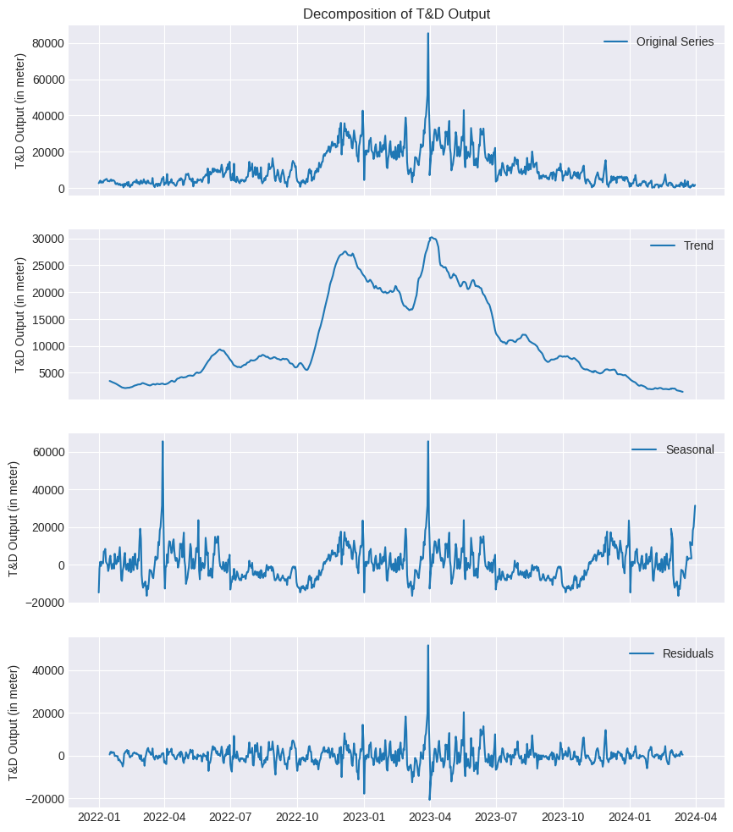
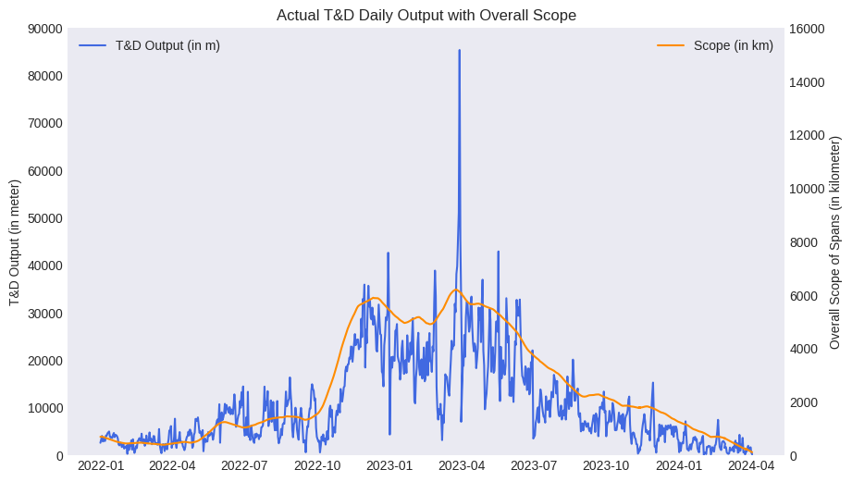
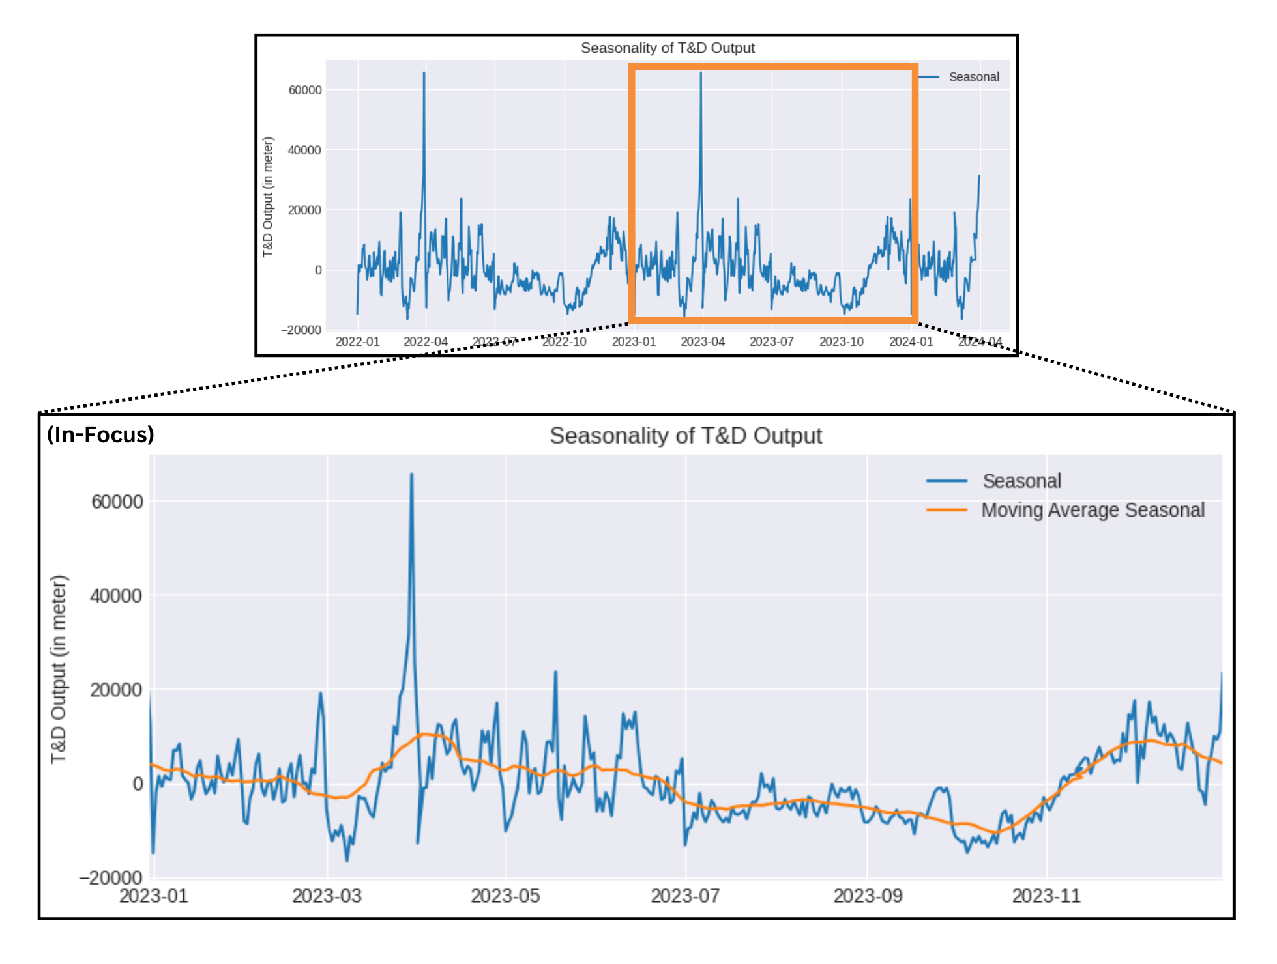
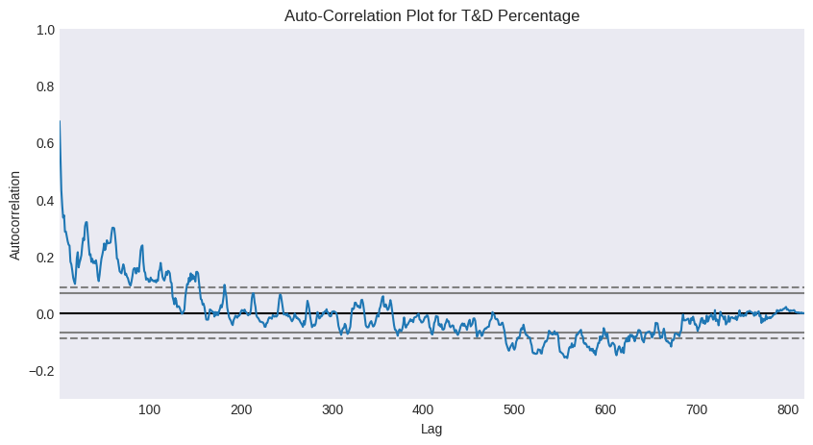
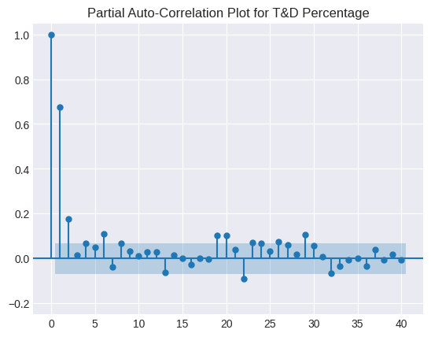
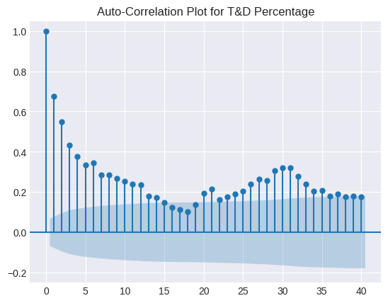
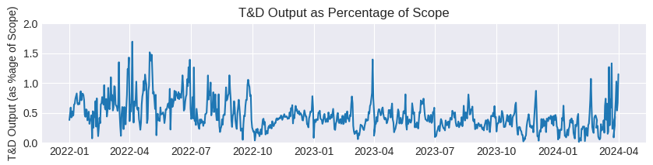
Data Analysis and Modelling
: SARIMAX
Time Series Analysis
Partial Auto-Correlation Function (PACF) Plot - 40 Lags
Seasonal Decomposition
Trend (In-focus)
Seasonality (In-focus)
Auto-Correlation Function (ACF) Plot
ACF Plot - 40 Lags
Upward Shock in October 2022; multiple deals signed in MP and Orissa
Taper-down post-June 2023; STL wanted to prevent backorders and finish pending commitments
Strong Correlation of T&D with Scope: 83.8%
Use T&D as Percentage of Scope (T&D Percentage) as the new target variable
Cyclical nature → SARIMAX over ARIMAX
First 3 lags are out of the significance limit → Upper Limit for Auto Regressive (AR) parameter ‘p’
First 15 lags are significant → Upper Limit for Moving Average (MA) parameter ‘q’
30-day Moving Average shows:
Peak in April
Overall High Productivity till June
Fall till October (Monsoon + Festive)
Increase till December
Slight downfall till March
Metrics
Percentage Difference:
8.44%
Exogenous Variable: Machine Count
No peaks but floats around the mean
Not as accurate as Regularised MLR OLS
Yet considers the Seasonality Effect
T&D Percentage exhibits stationarity; positive for time-series forecasting
Mathematically backed by the Augmented Dickey-Fuller Test:
Test-statistic = -5.6; p-value = 8.296×10⁻⁵; supports Stationarity
Training an Pyramid-ARIMA Auto-ARIMA model with upper limits
SARIMAX(3,1,1)x(1,0,[],30)
8

Slide 9
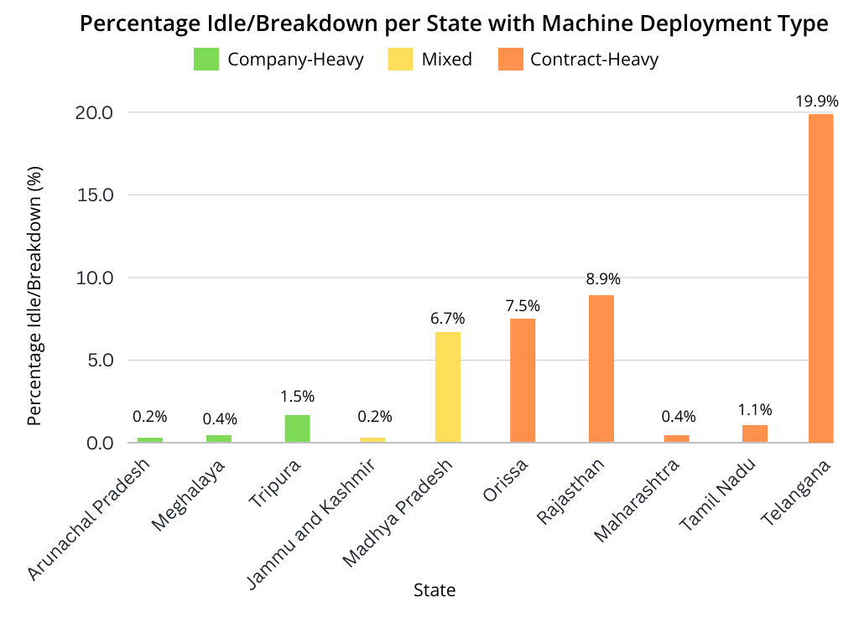



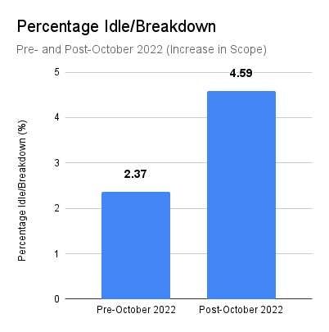
Results and Findings
Model Comparison
Regularised MLR OLS and SARIMAX perform well
MLR model obtains better accuracy
SARIMAX model considers the seasonality aspect
MLR model tends to Over-estimate
SARIMAX model tends to Under-estimate
Model Comparison
Ensemble Model
Combine the results of Regularised MLR OLS and SARIMAX
Reduces the Over and Under-Estimation
Percentage Difference: 1.07%
Mr. Singh and Mr. Kumar were pleased with the results
STL is testing the model for final deployment
Ensemble Model
Idle Capacity Analysis and Results
80% of machines contracted; 20% company-owned
Contract-heavy states tend to fall under the trap of under-utilization
Periods of High output immediately followed by periods of Low output → Erratic T&D Trendlines
Suggests overuse of labour and capital
2x increase in Percentage Idle/Breakdown after signing the MP and Orissa Deals in October 2022
Over-Estimation:.
Misallocation of Resources
Recruit more than necessary
Added Costs
Store-keeping; Extra salaries
Capital tied-up in inventory
Idle Capacity due to Under Utilization of Resources
Stressful Working Environment
Under-Estimation:.
Inefficient allocation of Resources
Recruit less men and machines
Inability to meet deadlines
Delays in final HOTO
Customer Dissatisfaction
Added Costs
Premium Pricing at short-notice
9

Slide 10
Recommendations
1
Forecasting Model and Data Improvement Strategies
2
Prevent Over-Utilization of Equipment
Ensemble Model delivers high accuracy
Robust: Properties of both Linear Regression and Time Series Analysis
Model can be tweaked for weekly, monthly or quarterly prediction
Model is easy to incrementally retrain for more data
More localised data (for e.g., soil conditions, climatic conditions, local authorities) could be captured
Current manual capacity planning overestimates the target
Conduct more vocational training regarding machine breaks and failure
Monitor machine usage either manually (field engineers) or automatically (sensors)
Establish a fixed work schedule
Enforce maximum operating hours (about 10 hrs/day)
Dedicate shifts for timely equipment maintenance
Thank You!
10

